Slide 1


Cauvery Polytechnic
Gonikoppal-571213

Slide 2

Session - 1
Kaushik A.P(402cs08033)

Slide 3

RESULT PROCESSING SYSTEM
RESULT PROCESSING SYSTEM

Slide 4

Team Members:
The Team:
*Kashi Vishwanath Aradhya
*Kaushik A.P
*Nandish B.A
*Noumya R.R
*Ramya K.P
402cs08032
402cs08033
402cs08044
402cs08051
402cs08062

Slide 5

Introduction

Slide 6

Result Processing System
This Application was developed by using VB 6.0 as front end and MS ACCESS 2003 as back end.

Slide 7

Literature Study:
*Referred Books:
Black Book
Gary Cornell[ P No. 605,606,607,610 (for graphics via code),
P No.647-662 (for mouse event)]
Deitel & Deitel [P No. 589 (for file, folder and drive lists)]
*Referred Websites:
1. http://www.about.com (Mike Chappel)
2.http://www.vbhelp.com
3.http://www.microsoft.com
4.http://www.sourcecode.com
5.http://www.opensource.com
6.http://www.vbmaniac.com

Slide 8
Performance against Goals

Slide 9

Goals:
The main goal of our project was “Easy Result Analysis” which facilitates both the lecturers and students to know their results.
And while presenting the result we thought it should be attractive. Hence, we planned to add a bar chart, the photo of the candidate and his result history.
Performance:
We were successful in completing the result analysis process using student, lecturer and administrator modules and implemented bar chart too.
As our project works with single result table at a time, we could not implement result history and displaying photo of the candidate was also not practical.
But we managed to implement some more applications like authenticating the administrator, updating the lecturer details, printing the result sheet etc.,

Slide 10
Performance against Schedule

Slide 11
Schedule:
> Project development time:
8 months(25/07/2010 – 25/02/2011)
> Submission of the synopsis:
25/07/2010
> Analysis:
29/07/2010 – 02/08/2010
> Requirement Collection: 02/08/2010 – 06/08/2010
> Design and Development:
09/08/2010 – 02/02/2011
> Testing
06/02/2011 – 25/02/2011
Performance:
> Project development time:
8 months(25/07/2010 – 25/02/2011)
> Submission of the synopsis:
28/07/2010
> Analysis:
31/07/2010 – 02/08/2010
> Requirement Collection: 03/08/2010 – 17/08/2010
> Design and Development:
17/08/2010 – 30/01/2011
> Testing
06/02/2011 – 22/02/2011

Slide 12
Session - 2
Ramya K.P(402cs08062)

Slide 13

Project Planning:
The core idea of our project was suggested by our H.O.D Sreenivasa K.
Combining his ideas with the suggestion from the team members we planned to developed this project satisfying all the conditions.
At the beginning the project was not well defined and no written plans were used.
We decided to work 3days/week(10 hrs) on the project and the total schedule should be less than 320 hrs.

Slide 14

System Requirements:
Hardware :
Processor: Intel PII or above.
Ram: 128 MB (Greater size Recommended).
Hard Disk: 15 GB.
Display Monitors:1024X720 pix.
Software :
Operating System: Windows XP or Above.
Applications: Visual Studio 6.0, MS ACCESS 2003 .

Slide 15

ER Diagram

Slide 16
c2
sem
EX1
c1
EX2
c3
name
EX8
Path records
Result record
Reg_no
IA1
IA8
IA2
N
N
Result
Subject
1
N
Lname
Desg
ID
Dept
slno
subname
Lecturer records
1
Subject
N
sname6
subject records
sname1
sname2

Slide 17

Connection Code:
Set con = CreateObject("adodb.Connection")
con.Open = "PROVIDER=MICROSOFT.JET.OLEDB.4.0;DATA SOURCE=" & "C:\db\SUBJECT.mdb "

Slide 18

Result Processing System
*Administrator *Lecturer *Student

Slide 19
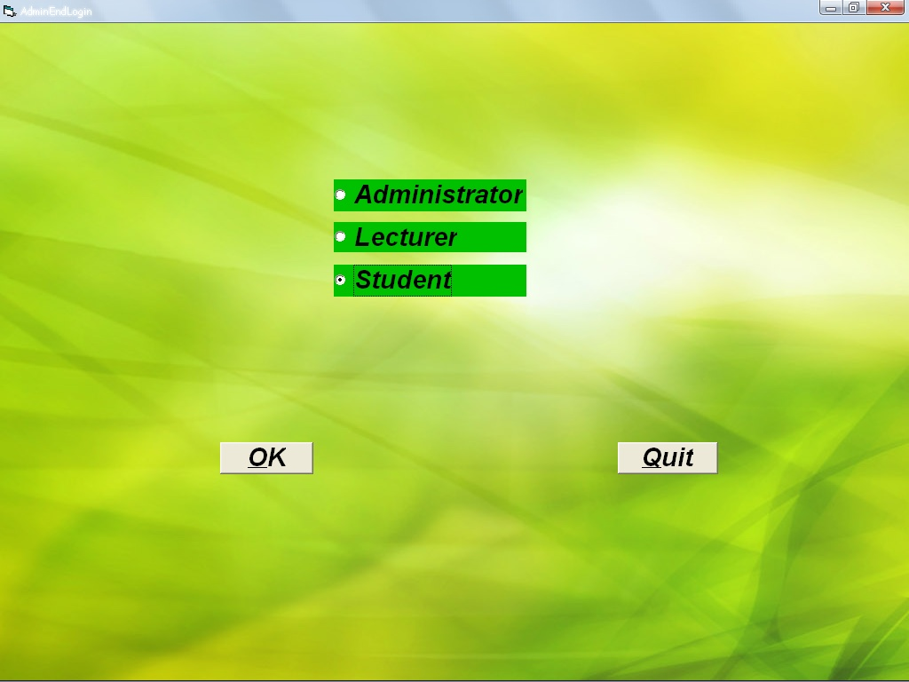

Slide 20
Session - 3
Noumya R.R (402cs08051)

Slide 21
Administrator:
*Select the Database
*Update:
*Password Update
*Lecturer Details
*Subject Details

Slide 22
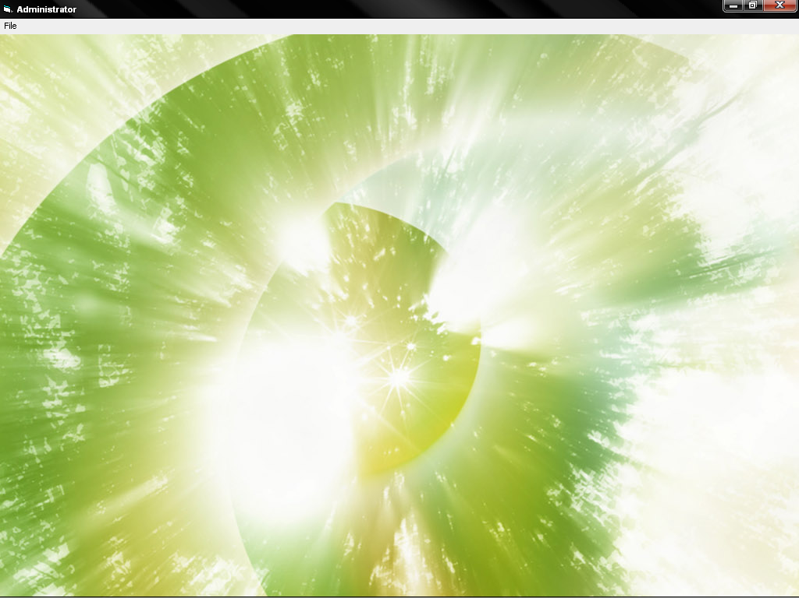

Slide 23

Lecturer:
*Helps lecturers in analysing their subject
marks, the number of distinctions, first
class etc.,
*Overall pass percentage both in values and
graph.

Slide 24
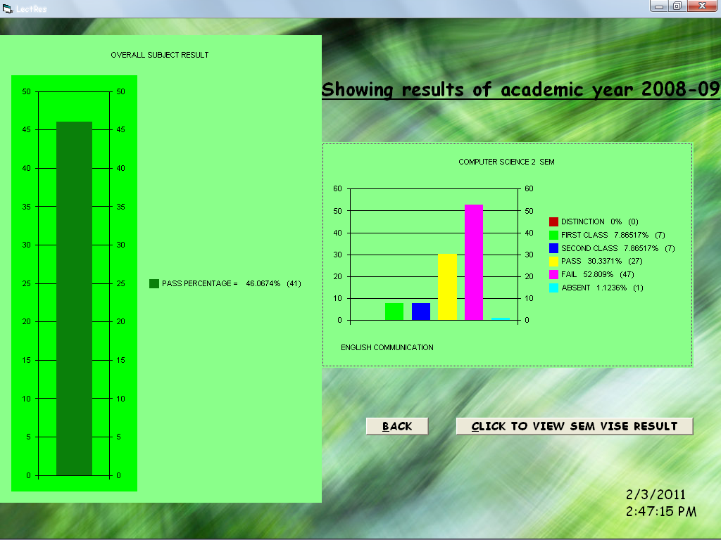

Slide 25
Session - 4
Nandish B.A (402cs08044)

Slide 26

Student:
*Helps students in analyzing their regular
subject marks, also their back subject marks.
*Both in values and graph.

Slide 27
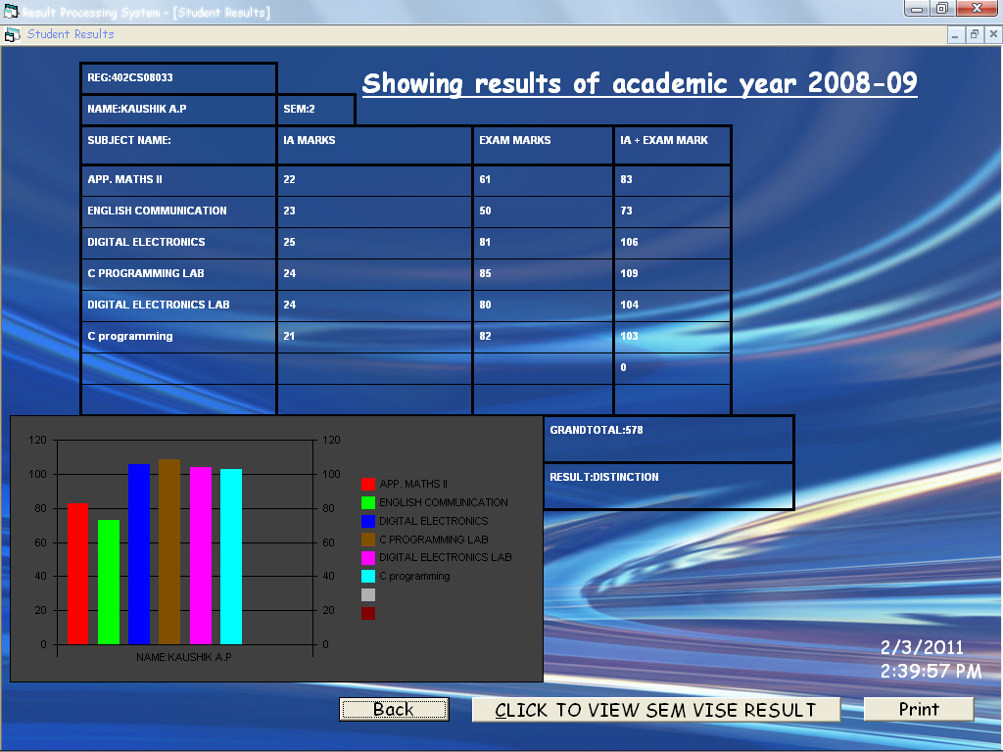

Slide 28
Session - 5
Kashi Vishwanath Aradhya (402cs08032)

Slide 29

Advantages
*Easy result analysis.
*Fast and accurate results.
*Easy maintenance of Lecturer
and subject results.
*Attractive result presentation.

Slide 30

Disadvantages
*Not applicable with internet.
*Works only with a particular
format of database.
*Maintains only one database
at a time.

Slide 31

THANK YOU

